Slide 1
Cellular Transport
Getting things in and out of a cell
Active
Endocytosis
Exocytosis
Passive
Diffusion
Osmosis

Slide 2
Cell Transport
Cell transport involves the exchange of molecules through the CELL Membrane
There are 2 main types of Cell Transport
Active Transport
Passive Transport

Slide 3
Active Transport
Small molecules move through using
Examples include
Active Transport (1)
Active Transport requires
Process of using energy to move materials through a membrane against the concentration gradient. Ex. Low to High
Proteins (3)
ATP Energy (2)
Glucose, amino acids, ions (Ca, Na) (4)

Slide 4
Active Transport
Exocytosis = “Out/Exit”
View Active Transport Brain Pop
Large molecules are transported by
Endocytosis = “In”
Examples: wastes, secretions, enzymes, hormones, insulin (8)
Endocytosis (5) and
Exocytosis (6)
Examples: food for unicellular organisms; bacteria that cause infection (7)

Slide 5
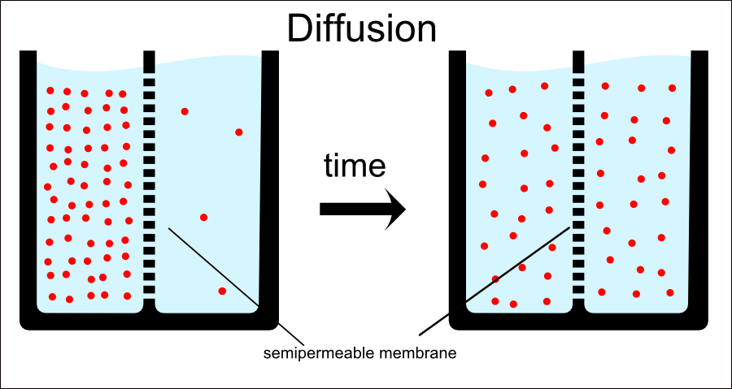
Passive Transport
Concentration Gradient:
The difference between a low concentration and a high concentration. (write this on the back of your notes)
Passive Transport (9)
Show Passive Transport Brain Pop
Movement of materials through a membrane without use of energy or down the concentration gradient.
Ex. High to Low

Slide 6
Passive Transport
Moves by Diffusion (10)
Small molecules move through the
The tendency of substances to move from an area of higher concentration (crowded) to an area of lower concentration (not crowded).
Cell Membrane (11)

Slide 7
Passive Transport
Larger molecules move through using
The Diffusion of water is Osmosis (14) NOTE: Osmosis is a TYPE of diffusion!
Proteins (12) which is also called Facilitated Diffusion (13)
The movement of water through a membrane from a higher concentration towards a lower concentration.

Slide 8
Diffusion
How do you smell Cinnabon from Old Navy?
How do you smell the boys locker rooms from the commons?
Show Diffusion Brain Pop
Smells (molecules) diffuse from high concentration area to areas of lower concentration

Slide 9
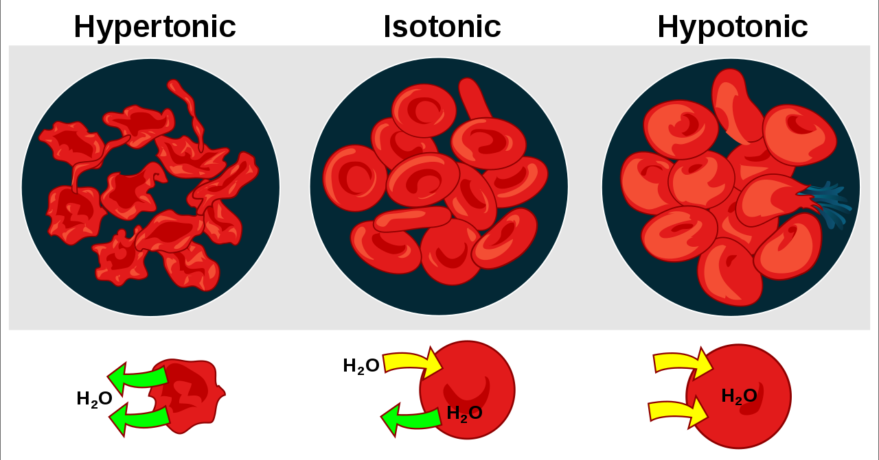
Osmosis Terms (AC Only)
Write on the back of your notes
Isotonic:
Hypotonic:
Hypertonic:
A solution that has the same solute concentration as another solution. The concentration on both sides remains constant and the cell does not change.
A solution that has a higher solute concentration than another solution. Water particles move out of the cell. This will cause the cell to shrink.
A solution that has a lower solute concentration than another solution. Water particles move into the cell. This will cause the cell to burst

